Slide 1
Retail Analysis in Berlin
Juan Acevedo

Slide 2
Introduction
Data could contribute to determining which borough is oversaturated by competitors and which one needs more convenience stores. Based on the number of residents in each borough and the number of grocery stores, it could be possible to determine where retailers can open a new store. Consequently, this project aims to determine where retailers can open new stores in the city of Berlin

Slide 3
Objectives
Cluster retail branches using Kmean
Identify the most popular retailer in the city of Berlin
Identify zones very competition is low and new stores can be open

Slide 4
Methodology
To accomplish the proposed objectives, data from Wikipedia was used to identify all boroughs and their population in the city of Berlin. This data was stored in an excel file and then imported, cleaned, saved as df_berlin using pandas Using ArcGis, the boroughs from df_Berlin were used to obtain their coordinates and saved in a new data frame. Next, the coordinates were merged with df_berlin .
The next step was to obtain the list of supermarkets from Foursquare's API, using category id supermarkets as a filter. The list was then processed to identify the most common supermarket per Neighborhood (figure 3) and then cluster using Kmean into 5 clusters to identify similarities inside the city.
Moreover, Foursquare's data was used to establish the most popular supermarket per quarter and then displayed using Folium. Similarly, using the demographic data from Wikipedia, it was possible to calculate the number of clients per store in each quarter

Slide 5
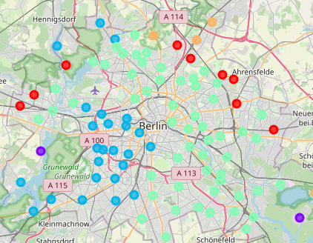
Results
Cluster distribution
The most common cluster is blue and green around the city center, while outside the city center cluster red, orange and Purple are more common. The map indicates that retailers' distribution in the city center is similar and varies on the edges of the city.
Cluster 4
Cluster 0
Cluster 0
Cluster 3
Cluster 1
Cluster 2
Cluster 1

Slide 6
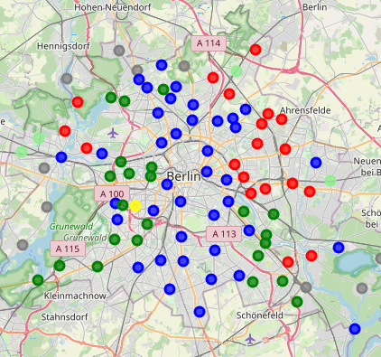
Results
Cluster distribution
The following maps illustrate the most common retail per quarter by color. The distribution of colors was assigned as follows:
Blue = Lidl, Green = Aldi, Red = Rewe, Yellow = Edeka, Grey = others.
Rewe
Lidl
Aldi
Aldi

Slide 7
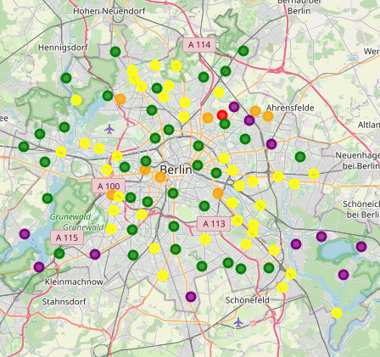
Results
Most common retailer per quarter
Business Opportunities
Colors
Red = less than 50 customers per store,
Orange = between 51 and 200 customers per store,
yellow = between 201 and 1000 customers per store,
green = between 1001 and 2001 customers per store
purple = more than 2000 customers per store.
The red color and orange color indicates an oversaturated market where stores may not be profitable. The yellow stores where the number is ok but with a low number of customers. Green indicates areas where stores must be profitable due to the high number of customers and purple new business opportunities where stores can be open.

Slide 8
Conlusions
Most the distribution of retail branches is very similar in the city center and varies in the edges of the city.
Retailers dominate specific areas of the city except for the northwest, where several players dominate each quarter.
It was possible to determine that new business opportunities can be found in near the borders of the city.

